Slide 1


Foundations of
Scientific Computing
(SciComp 101)
Dave Biersach
dbiersach@bnl.gov
Session 03
Python Container Types

Slide 2
Session 03 – Goals
Use the five Python built-in container types: list, tuple, set, string, dictionary
Perform standard CRUD actions (create, read, update, delete) on items in those five container types
Differentiate mutable vs. immutable containers
Compare and contrast lists, strings, tuples, and sets in terms of when to use each type of container
Use the Python “pretty printer” (pprint) to display dictionaries where the keys are sorted alphabetically

Slide 3
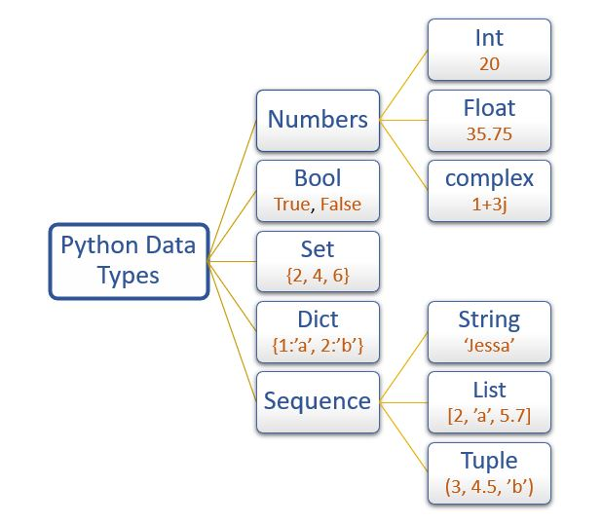
Python’s Built-in Data Types
Only
sequence types support indexed [] access
But you can use enumerate() with all of these data types

Slide 4
Python Lists
Python Lists are ordered and indexable - items keep their position, and you can access or slice them with a[0], a[-1], a[2:5], etc.
Lists are mutable - You can change items in place: a[1] = 10, or replace slices: a[2:4] = [7, 8, 9]
Lists can be heterogeneous - A single list can contain integers, strings, floats, etc., including other lists
CRUD operations are simple and expressive - Create ([] or list()), Read (a[i]), Update (a[i]=...), Delete (del a[i]), plus helpers like .append(), .insert(), .pop(), .remove()
Lists are dynamic and grow/shrink efficiently - You don’t pre-declare size; append() and extend() operations are fast

Slide 5
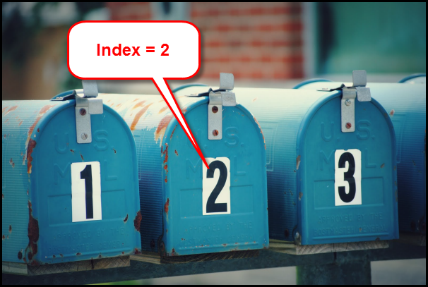
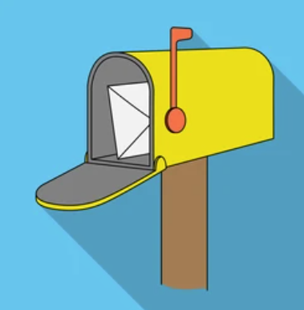
Index Number versus Item Value
list_name[2]

Slide 6
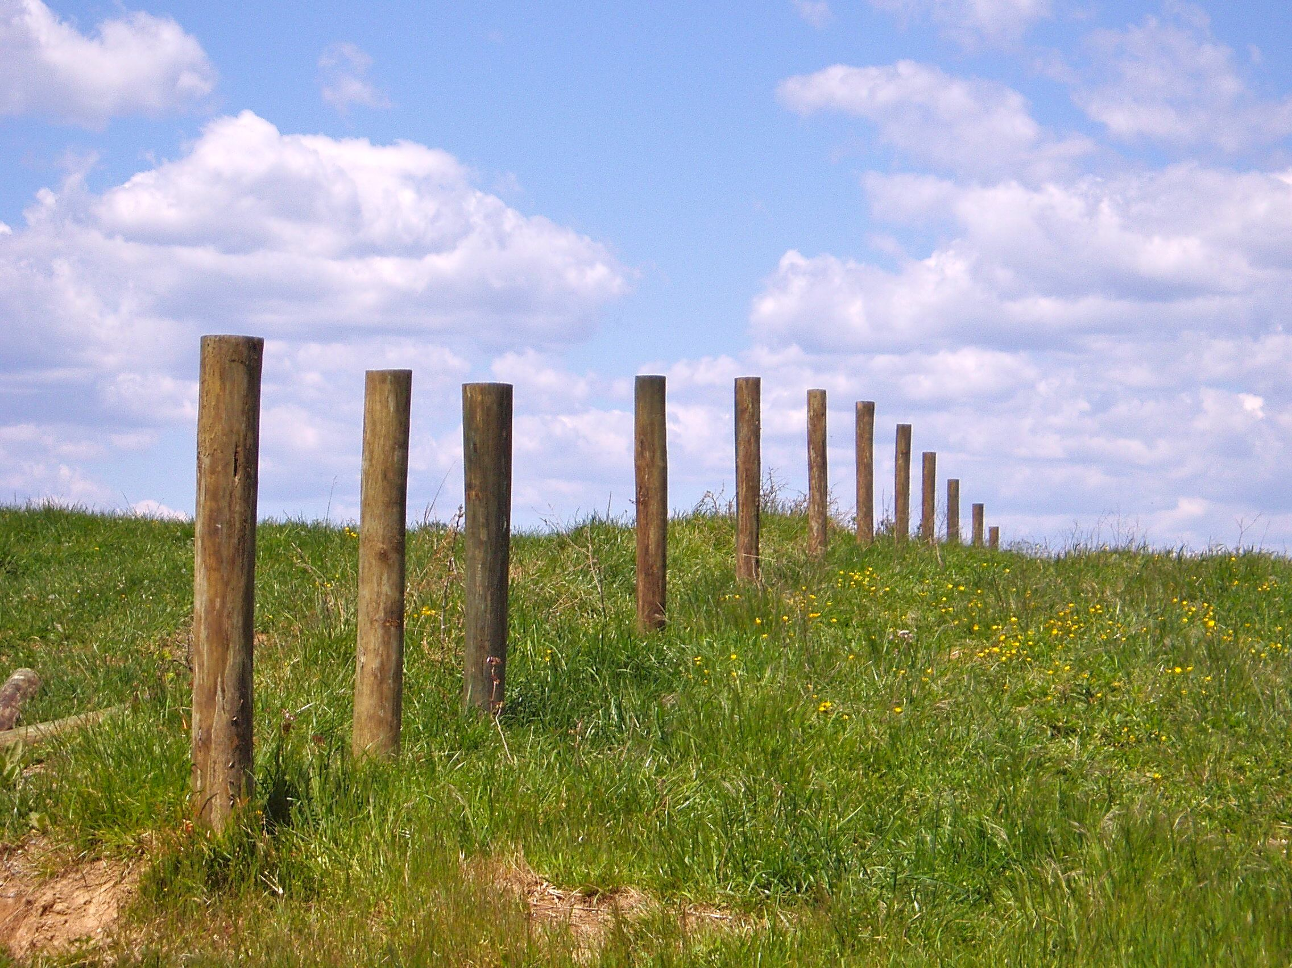
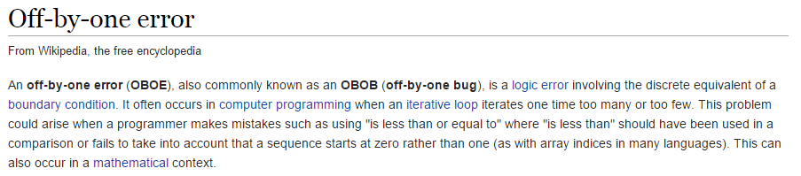
The Bane of All Programmers
This problem is why we all agree to always use ZERO as the first index value in a collection.
Remember…
ZERO is a THING!
A farmer needs a fence 100m long
He wants 2m between each fence post
How many posts does he need?

Slide 7
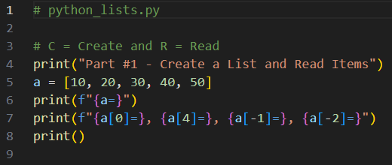

Edit then Run python_lists.py
You must type in this code
①
②
③
④

Slide 8
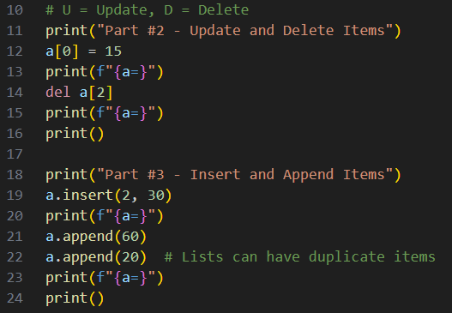
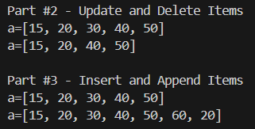
Edit then Run python_lists.py
You must type in this code
①
②
③
④
⑤

Slide 9
Python Slicing Syntax
If zero colons, a[i] - return the single item at index i
If one number to the left of one colon, a[i:] – return the item at index i and all remaining items
If one number to the right of one colon, a[:i] – return all items before but not including the item at index i
If two numbers and one colon, a[i:j] - return all items starting at index i, but not including the item at index j
If three numbers and two colons, a[i:j:k] – return all items starting at index i, but not including the item at index j, with step size (stride) of k items

Slide 10
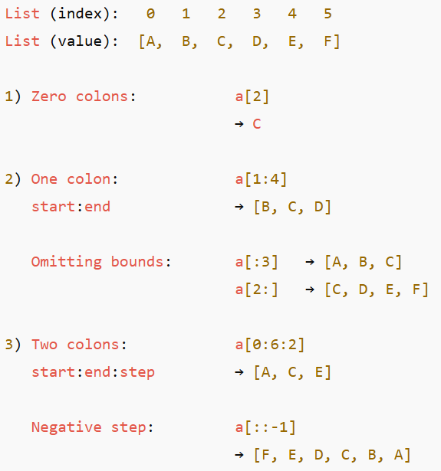
Python Slicing Syntax
①
②
③
④
⑤
⑥

Slide 11
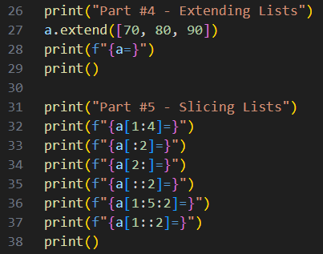
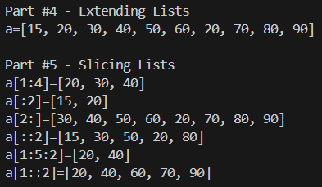
Edit then Run python_lists.py
You must type in this code
①
②
③
④
⑤
⑥
⑦

Slide 12
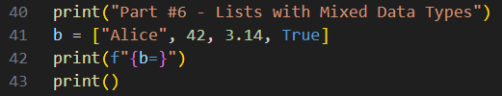

Edit then Run python_lists.py
You must type in this code
①
②

Slide 13
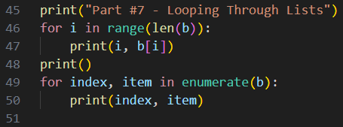
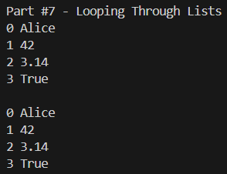
Edit then Run python_lists.py
You must type in this code
①
②
③
④
⑤

Slide 14
Python Tuples
A tuple is like a Python list in that it is a container of items and supports the [] index operation
However, tuples are immutable: they cannot be changed in any fashion after they are created
No item values can be changed, no new items can be inserted or appended, no existing items can be deleted
To change an existing tuple, you must create a new tuple based on that existing tuple
Python tuples are denoted using parentheses (), whereas lists are denoted using square brackets []
An empty tuple would be declared as ()

Slide 15
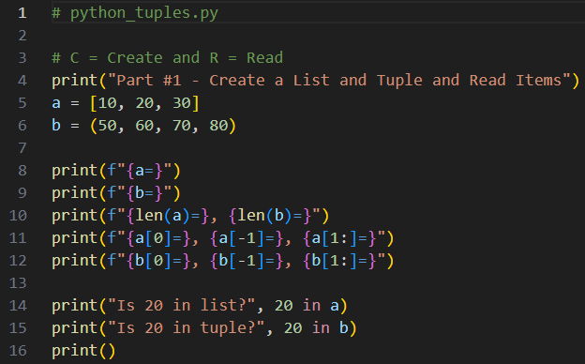
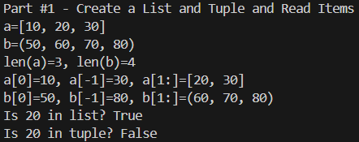
Edit then Run python_tuples.py
You must type in this code
①
②
③
④
⑤

Slide 16
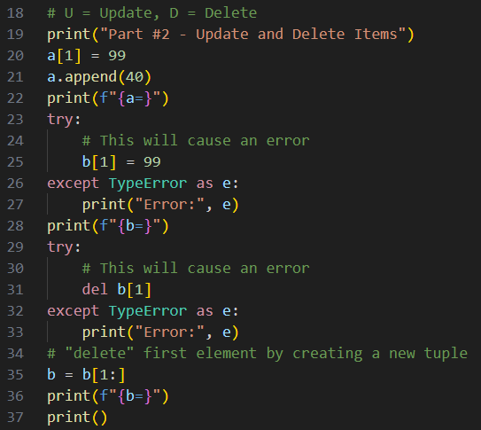
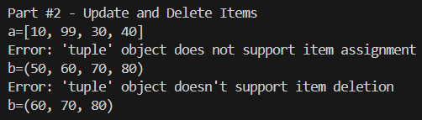
Edit then Run python_tuples.py
You must type in this code
①
②
③
④
⑤

Slide 17
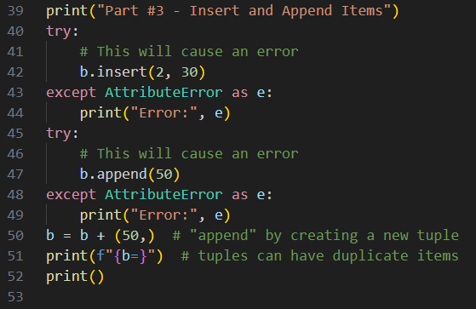

Edit then Run python_tuples.py
You must type in this code
①
②
③

Slide 18
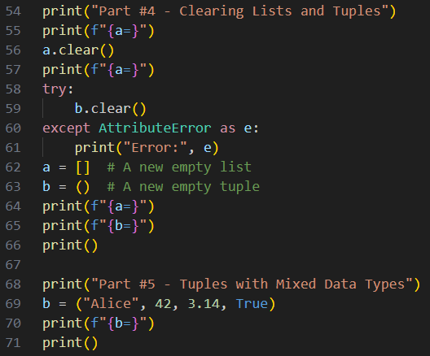
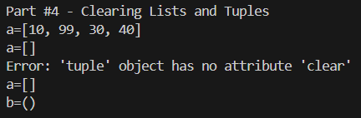

Edit then Run python_tuples.py
You must type in this code
①
②
③
④
⑤

Slide 19
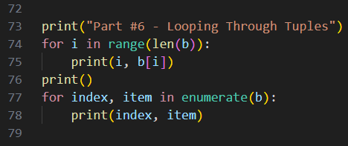
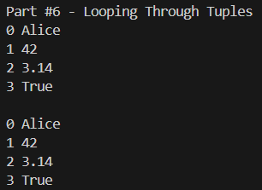
Edit then Run python_tuples.py
You must type in this code
①
②
③
④

Slide 20
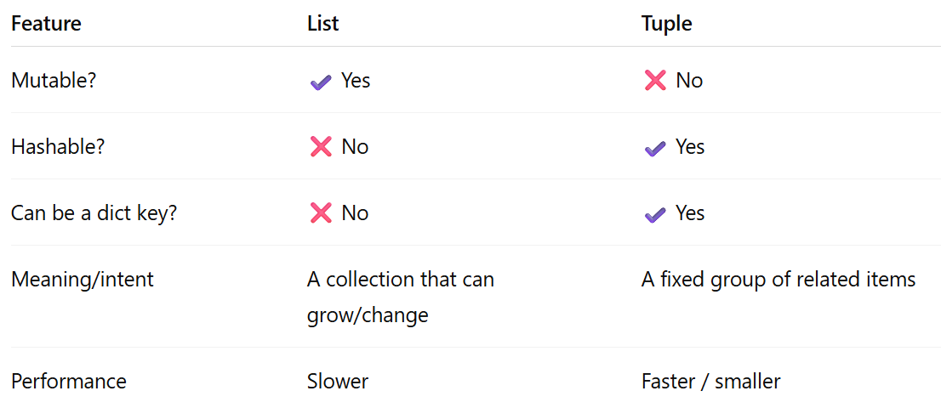
Python Lists vs. Tuples

Slide 21
Python Sets
A set in Python is a special container of items that DOESN’T support the [] index operation – items are not ordered (they don’t exist at a specific location within a set)
However, a set can be iterated using a for loop
Sets are mutable to some degree: new unique items can be added to a set (duplicate values are automatically ignored) and items can be deleted/removed/discarded
Sets support union, intersection, and difference operations
Python sets are denoted using curly braces, but an empty set would be declared as set() rather than empty braces {}

Slide 22
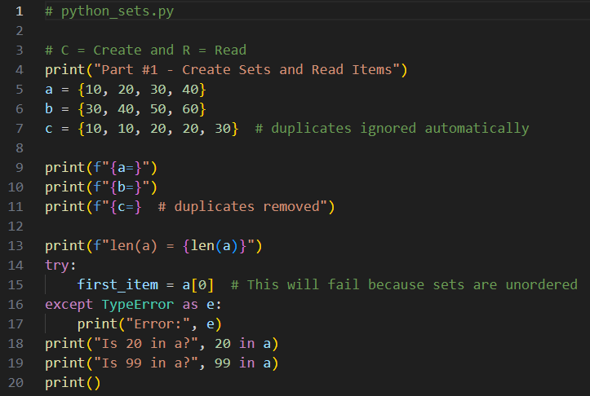
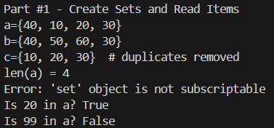
Edit then Run python_sets.py
You must type in this code
①
②
③
④
⑤
⑥
⑦
⑧

Slide 23
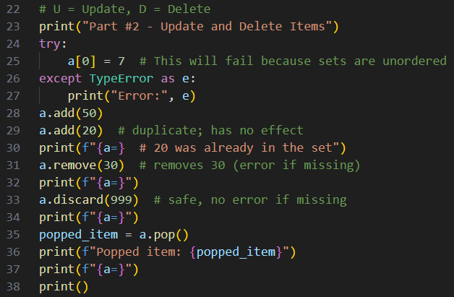
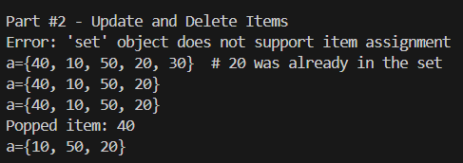
Edit then Run python_sets.py
You must type in this code
①
②
③
set.pop() removes an arbitrary element, not necessarily the first element,
in the set, as sets have NO order
④
⑤
⑥

Slide 24
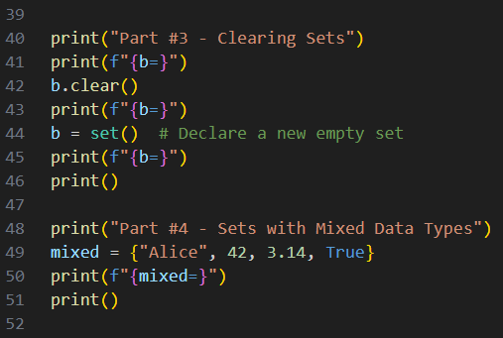
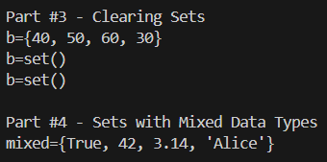
Edit then Run python_sets.py
You must type in this code
①
②
③
④

Slide 25
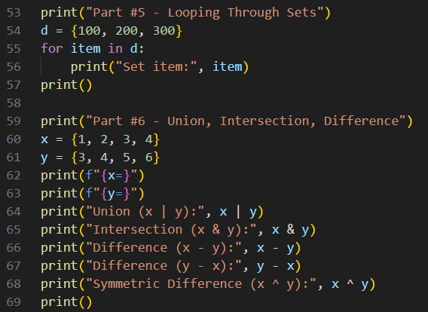
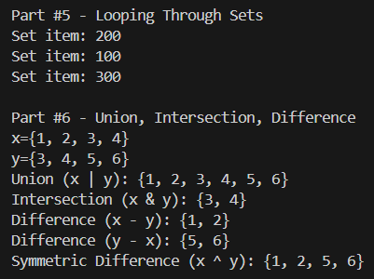
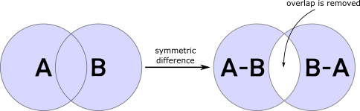
Edit then Run python_sets.py
You must type in this code
①
②
③
Python sets are unordered
④
⑤
⑥
⑦
⑧

Slide 26
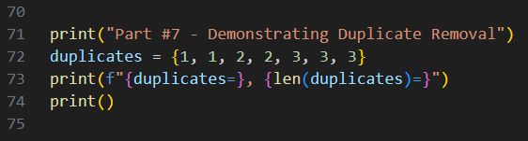

Edit then Run python_sets.py
You must type in this code
①
②

Slide 27
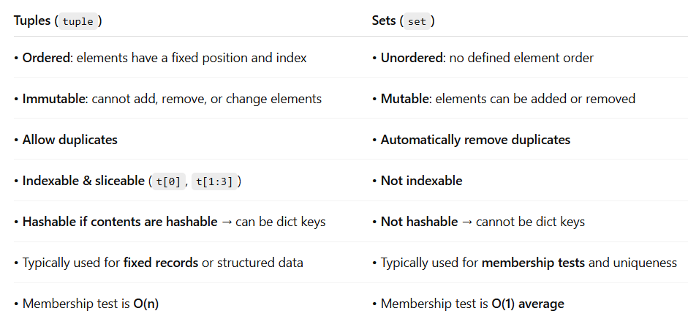
Python Tuples vs. Sets

Slide 28
Python Strings
A string (str) in Python behaves like a read-only list of characters
Strings are immutable - once a string is created, it cannot be changed in place. Any “modification” (like .replace() or concatenation) creates a new string
Strings are sequences with indexing and slicing. You can access characters using zero-based indexing (s[0]) and slicing (s[1:4])
Strings use Unicode, not just ASCII. Python strings represent Unicode text (e.g., emojis, accented characters, non-Latin scripts). Encoding (e.g., UTF-8, UTF-16) matters when converting between str (text) and bytes (raw data)

Slide 29
Reversing a String
"Forever Young"
We could try to swap each letter around the middle element, but that would require complicated code

Slide 30
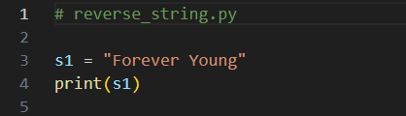

Edit then Run reverse_string.py
You must type in this code
①
②

Slide 31
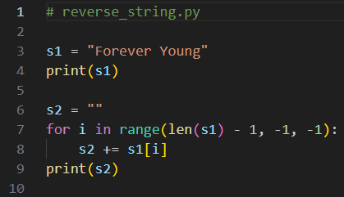
Edit then Run reverse_string.py
You must type in this code
①
②
③
④
In Python, we concatenate (join) strings using the plus sign (addition) operator

Slide 32
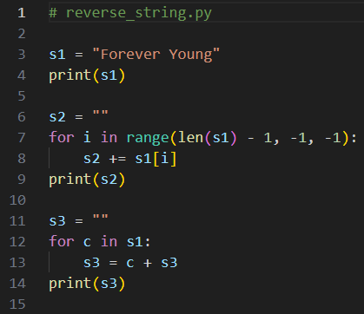
Edit then Run reverse_string.py
You must type in this code
In Python, for loops can iterate through something that is iterable
Sequence: list, tuple, string (str), range()
Mappings: dictionary (dict)
Files: iterates over lines
Generators: any object with __iter__() and __next__()
①
②
③
④

Slide 33
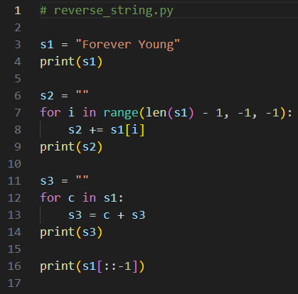
Edit then Run reverse_string.py
You must type in this code
Slicing syntax: [start : stop : step]
If no value is given for the start index, the default value of 0 is assumed
If no value is given for the stop index, the default value is the index of the last accessible element in the list (len), and the stop value is exclusive
If no value is given for the step value, the default value of 1 is assumed
①

Slide 34
Python Dictionaries
Python dictionaries store data as key-value pairs
You access dictionary values using keys, not index numbers. This makes dictionaries ideal when a name or label best identifies data, whereas lists are best when order and position matter
Dictionaries are mutable, meaning you can add, remove, or change key–value pairs after creation. Like lists, they grow and shrink dynamically—but unlike lists, dictionaries are unordered by design
Dictionaries support standard CRUD operations, including iteration. Dictionary lookups are speedy, making them more efficient than lists for searching by identifier

Slide 35
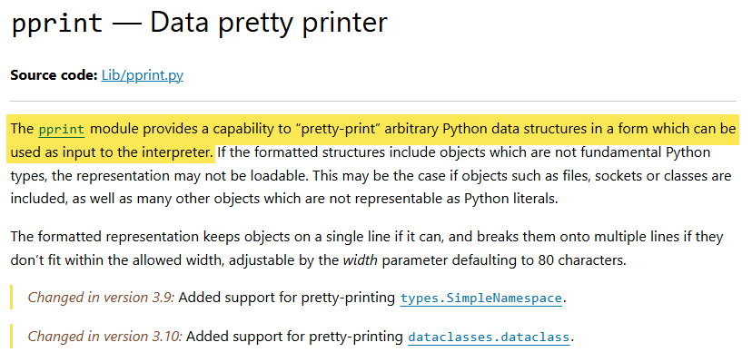
The Python Data “pretty printer”
https://docs.python.org/3/library/pprint.html

Slide 36
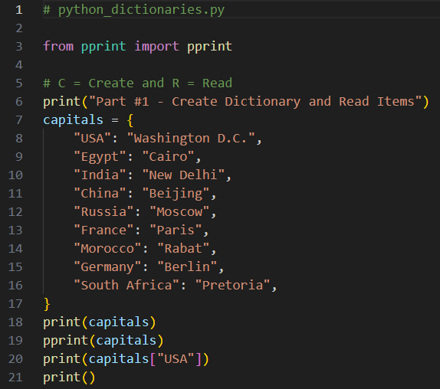
Edit python_dictionaries.py
You must type in this code
①
②
③

Slide 37
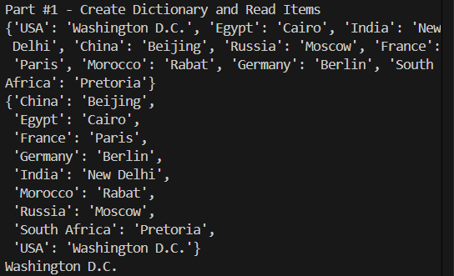
Run python_dictionaries.py
①
The pretty-printer (pprint) alphabetizes the displayed keys and places each key-value pair on its own line for easy reading
③

Slide 38
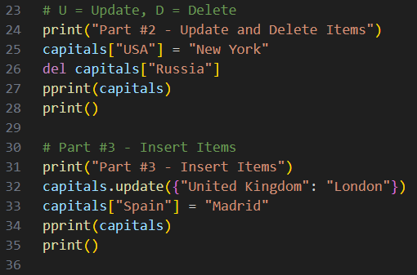
Edit python_dictionaries.py
You must type in this code
①
②
③
④
⑤

Slide 39
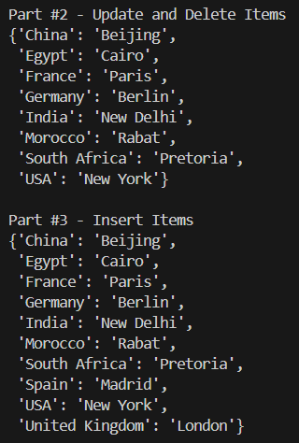
Run python_dictionaries.py
①
④
③
②

Slide 40
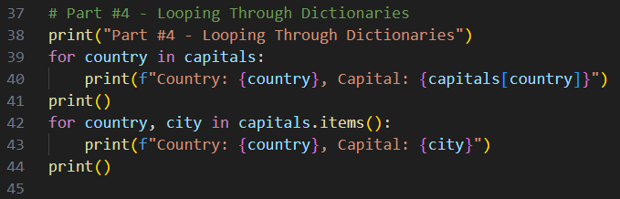
Edit python_dictionaries.py
You must type in this code
①
②
③
④

Slide 41
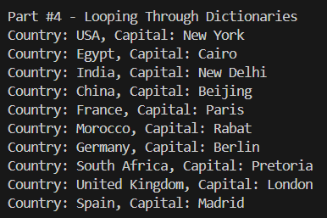
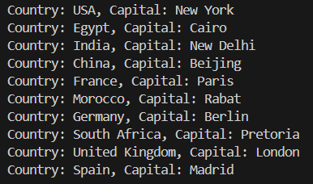
Run python_dictionaries.py

Slide 42
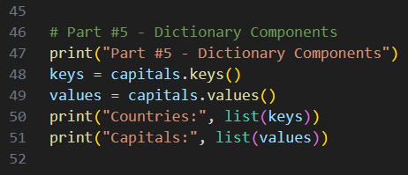
Edit then Run python_dictionaries.py
You must type in this code
①
②
③
④

Slide 43
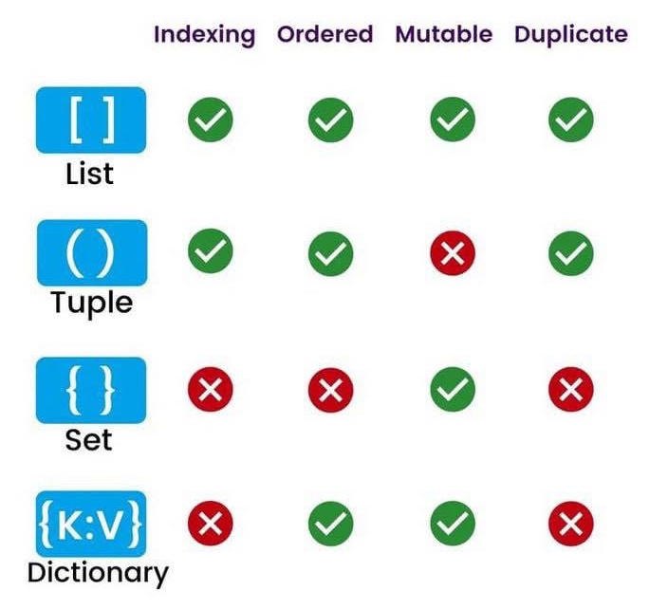
Python Data Structures

Slide 44
Session 03 – Now You Know…
How to declare the five Python built-in container types: list, tuple, set, string, dictionary
How to perform standard CRUD actions (create, read, update, delete) on items in those five container types
The difference between mutable vs. immutable containers
The similarities and differences between lists, strings, tuples, and sets
Use the Python “pretty printer” (pprint) to display dictionaries where the keys are sorted alphabetically

Slide 45
TASK 03
Update the program sum_multiples.py to display the sum of all natural numbers less than 1900 that are divisible by both 7 and 11

